Slide 1
IoT Device Simulation Demo
Venky Dahale (DS)
Arpana Brahmbhatt (IE)
Sridhar Kothalanka (CSA)
Mar 2020

Slide 2
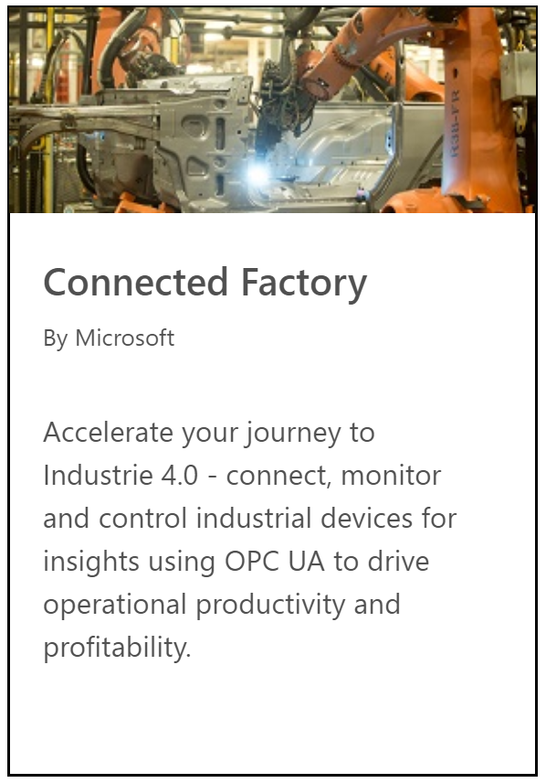
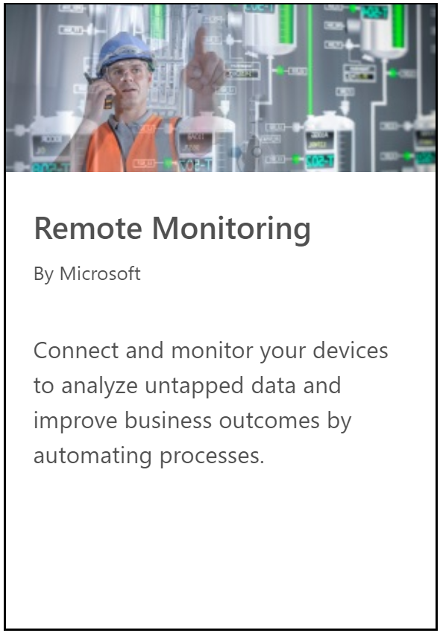
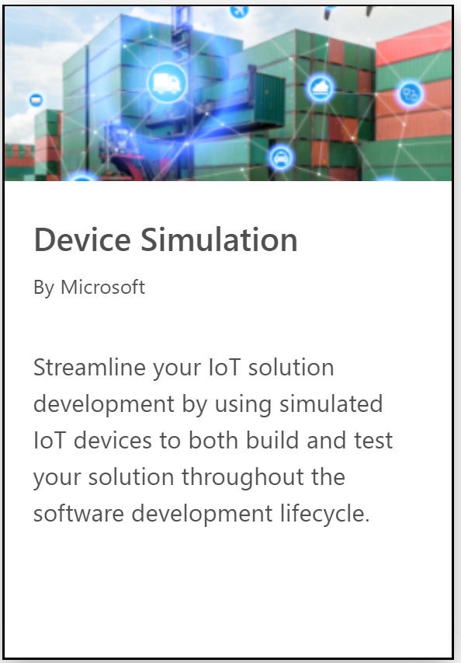
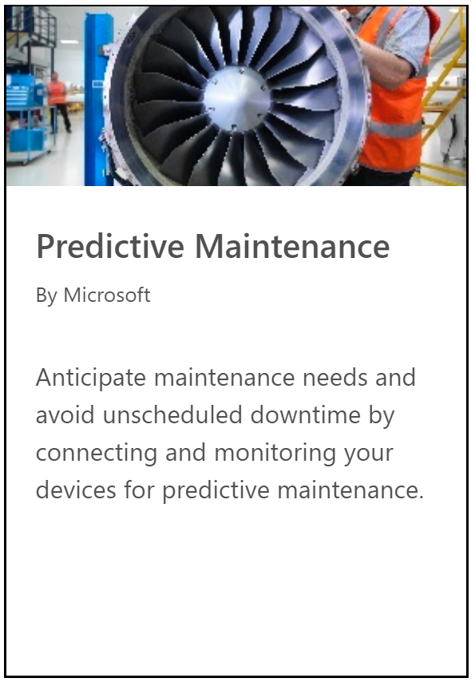
Microsoft IoT solution Accelerators
IoT solution accelerators are complete, ready-to-deploy IoT solutions that implement common IoT scenarios.

Slide 3

Device Simulation Benefits
Quickly get a prototype up and running and iterate by adjusting simulated device behavior on the fly
Validate the solution works as expected from device to solution by simulating real-world device behavior
Scale test your solution by simulating normal, peak and beyond peak load conditions

Slide 4
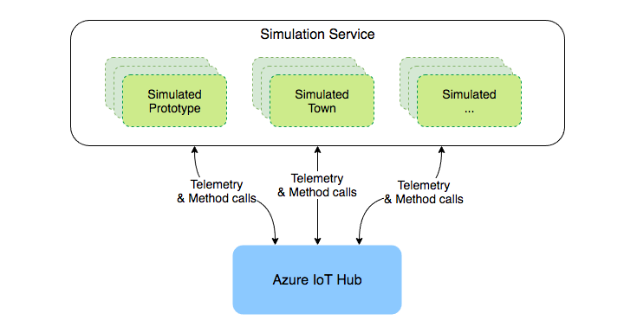
Overview
https://github.com/Azure/device-simulation-dotnet
Time Series Insights

Slide 5
Demo
Login to Azure Solution Deployment Service
Select the “Device Simulation” accelerator option
Create device simulator
Automatic resources provisioning
Verify deployment of resources in Azure portal
Launch the solution
Note the default device models
Select the “Sample Simple Simulation”
Run the simulation

Slide 6
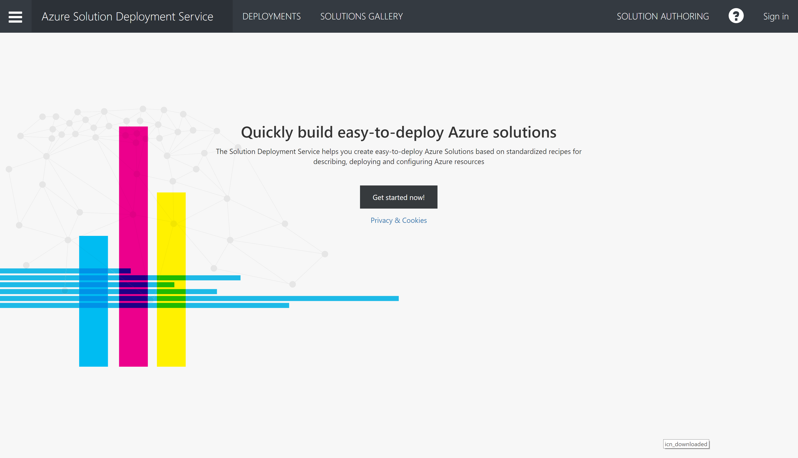
Step 1
https://sds.azureiotsolutions.com/

Slide 7
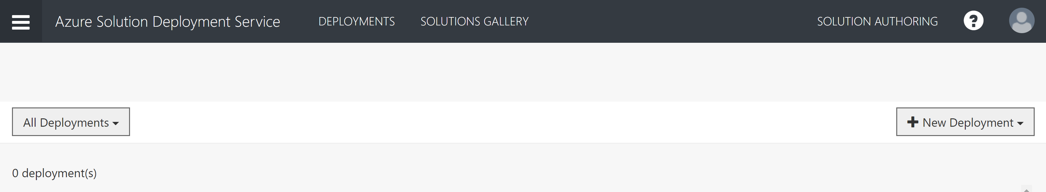
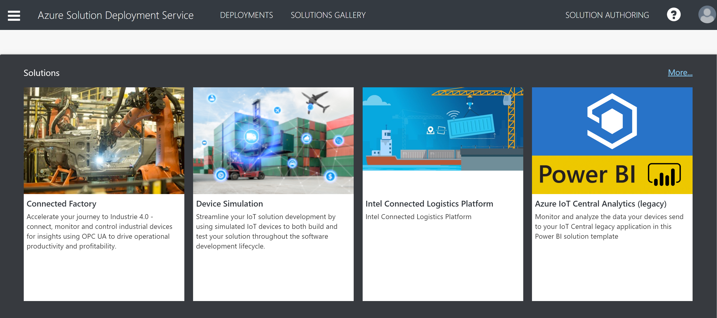
Step 2

Slide 8
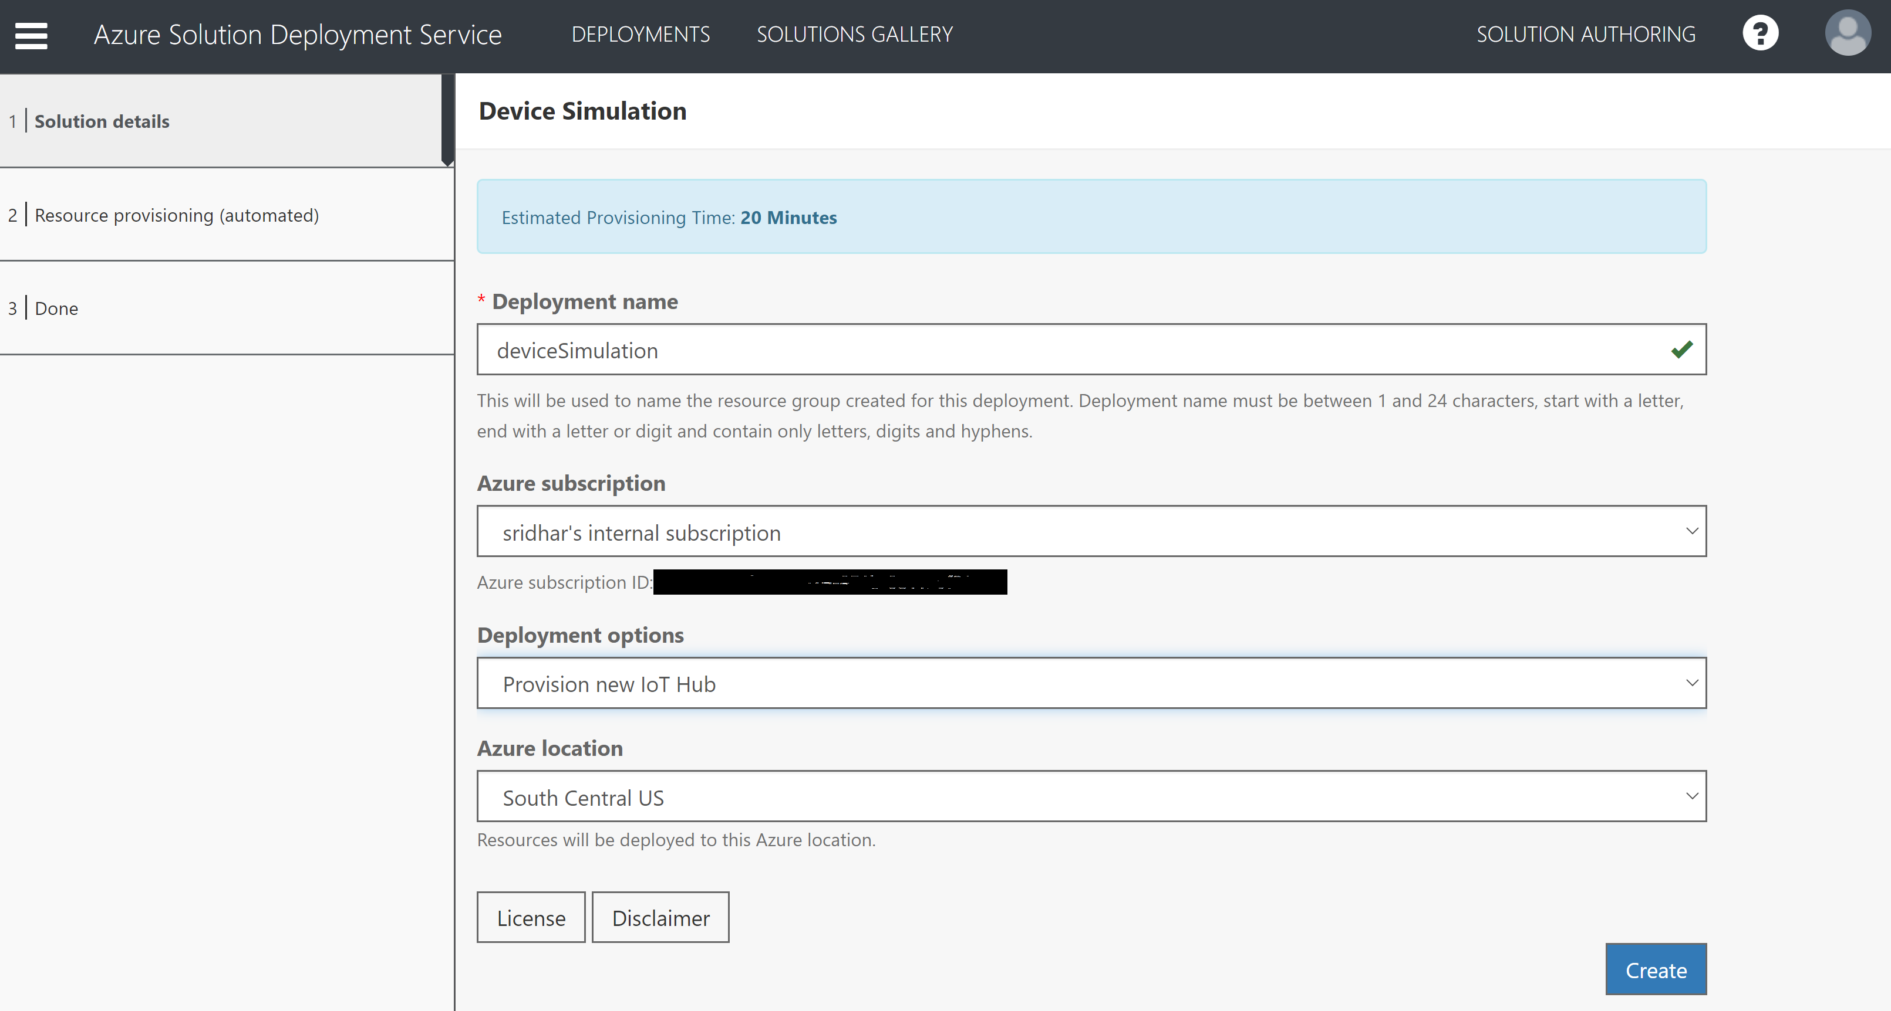
Step 3

Slide 9
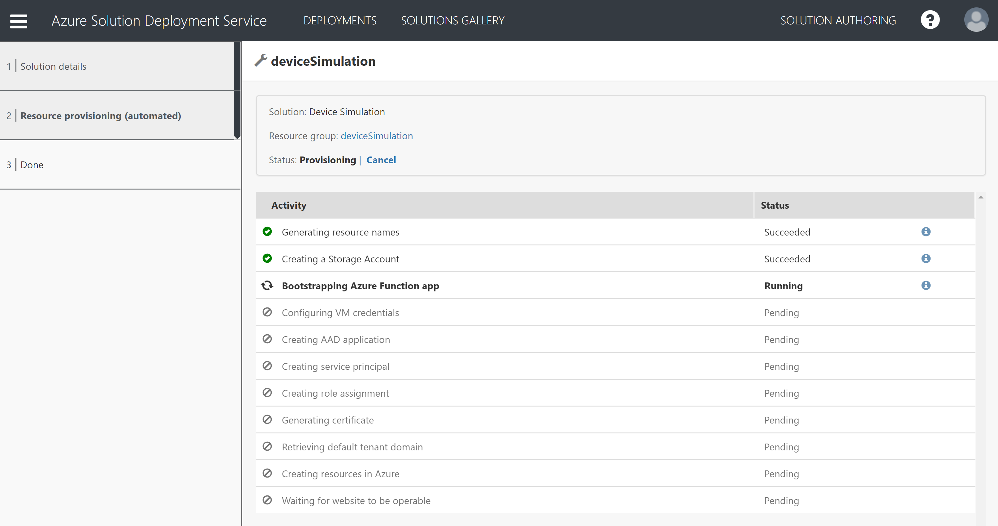
Step 4
Wait for deployment to complete

Slide 10
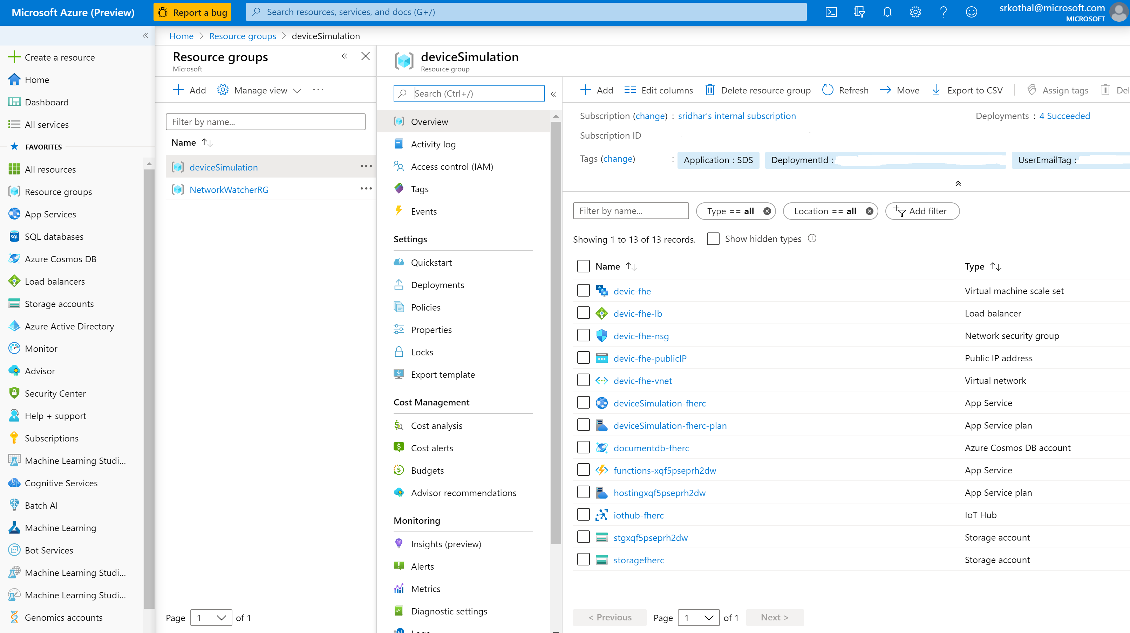
Step 5
Note resources get deployed in your subscription

Slide 11
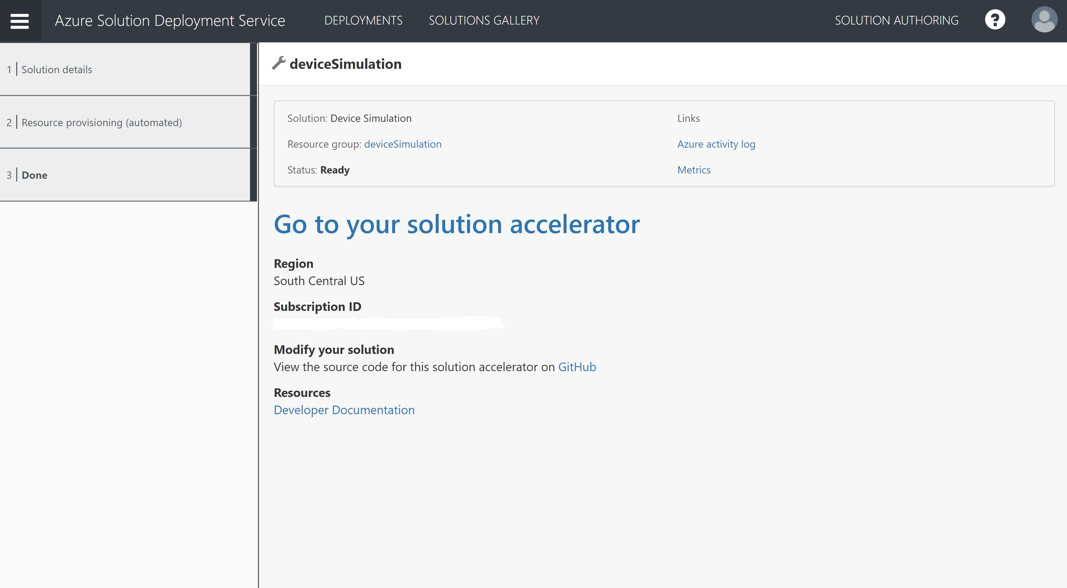
Step 6

Slide 12
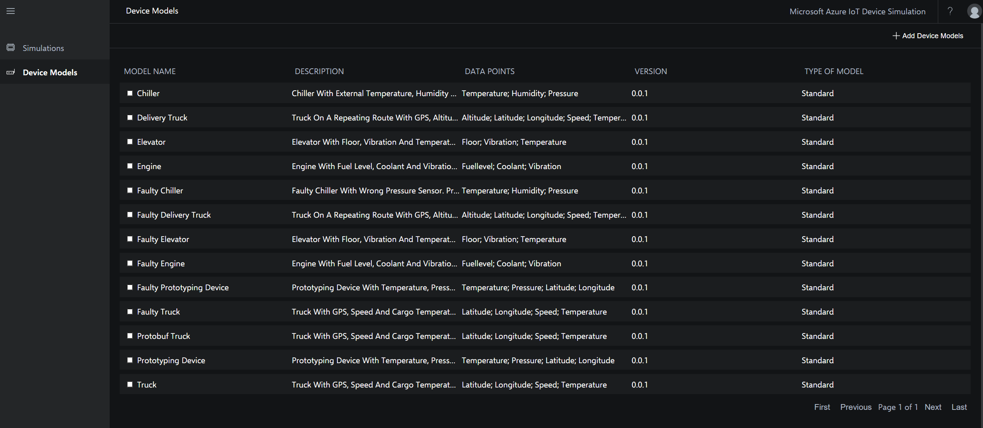
Step 7
Default device models

Slide 13
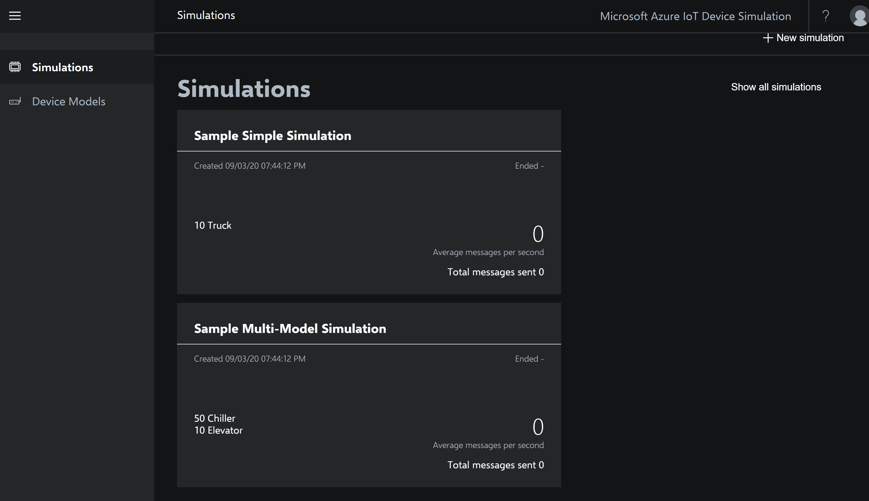
Step 8

Slide 14
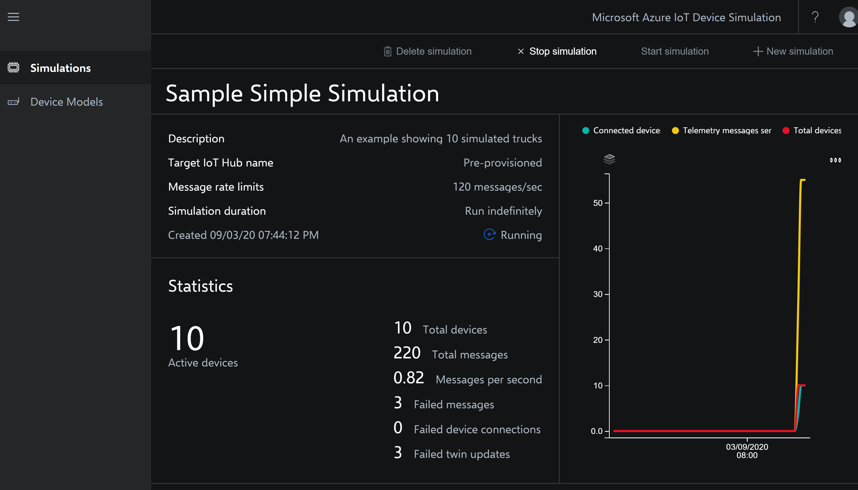
Step 9

Slide 15
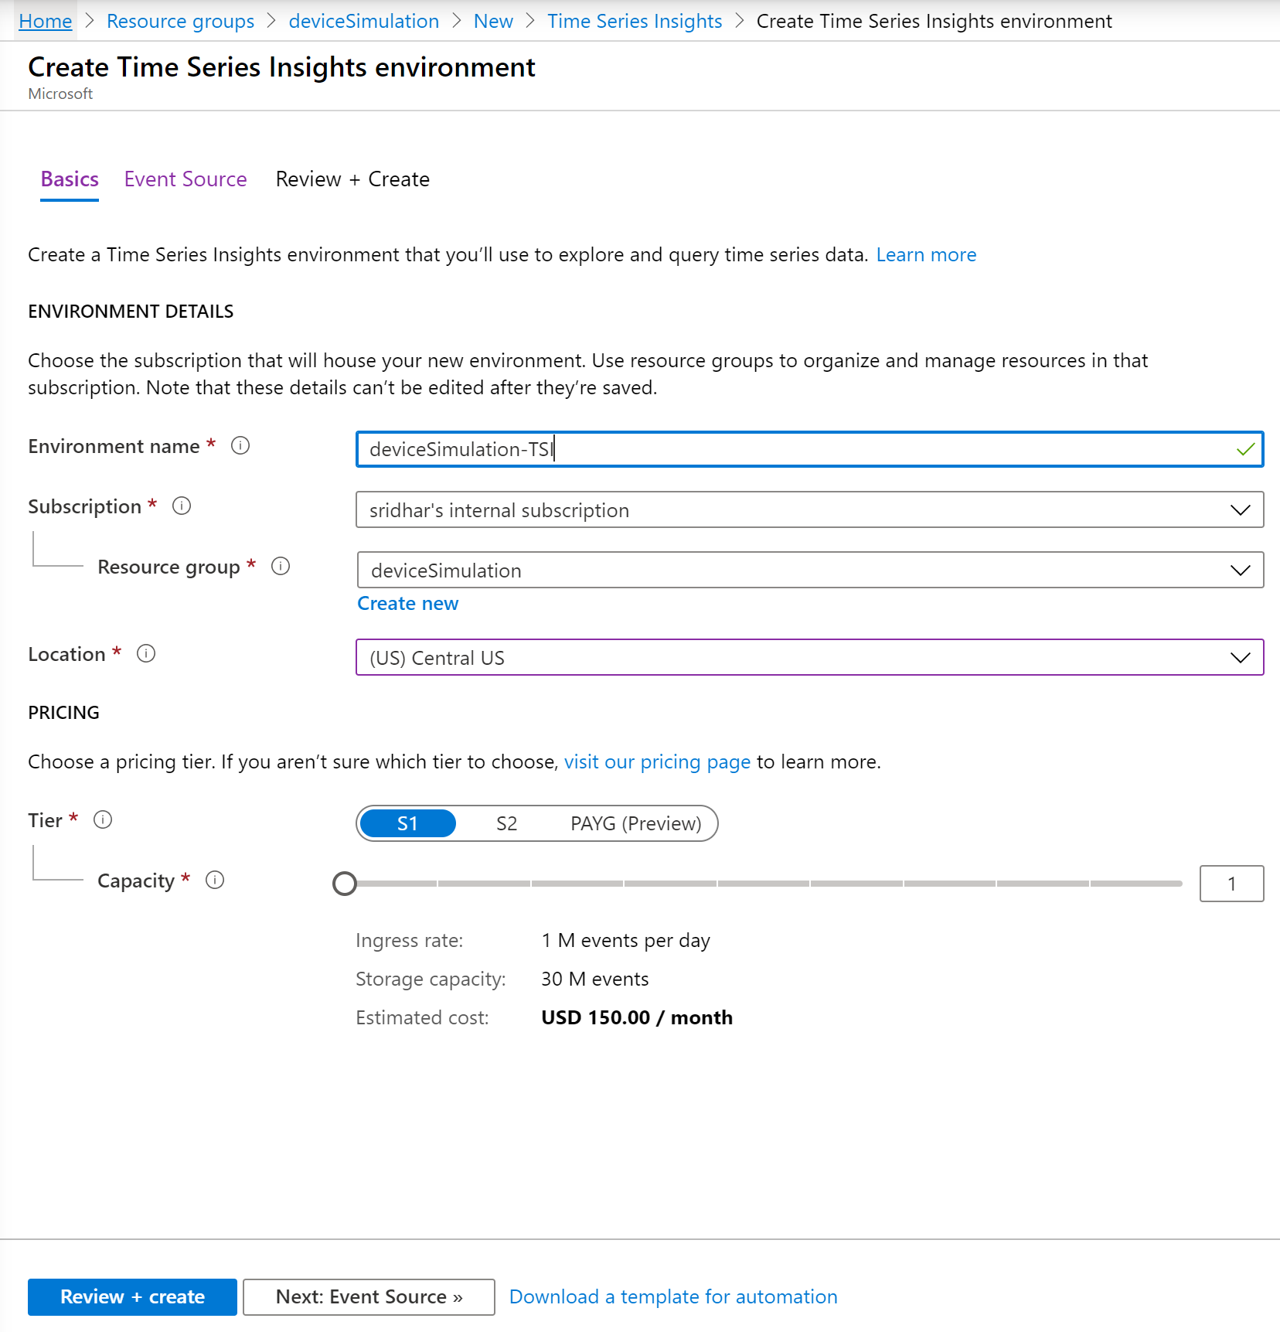
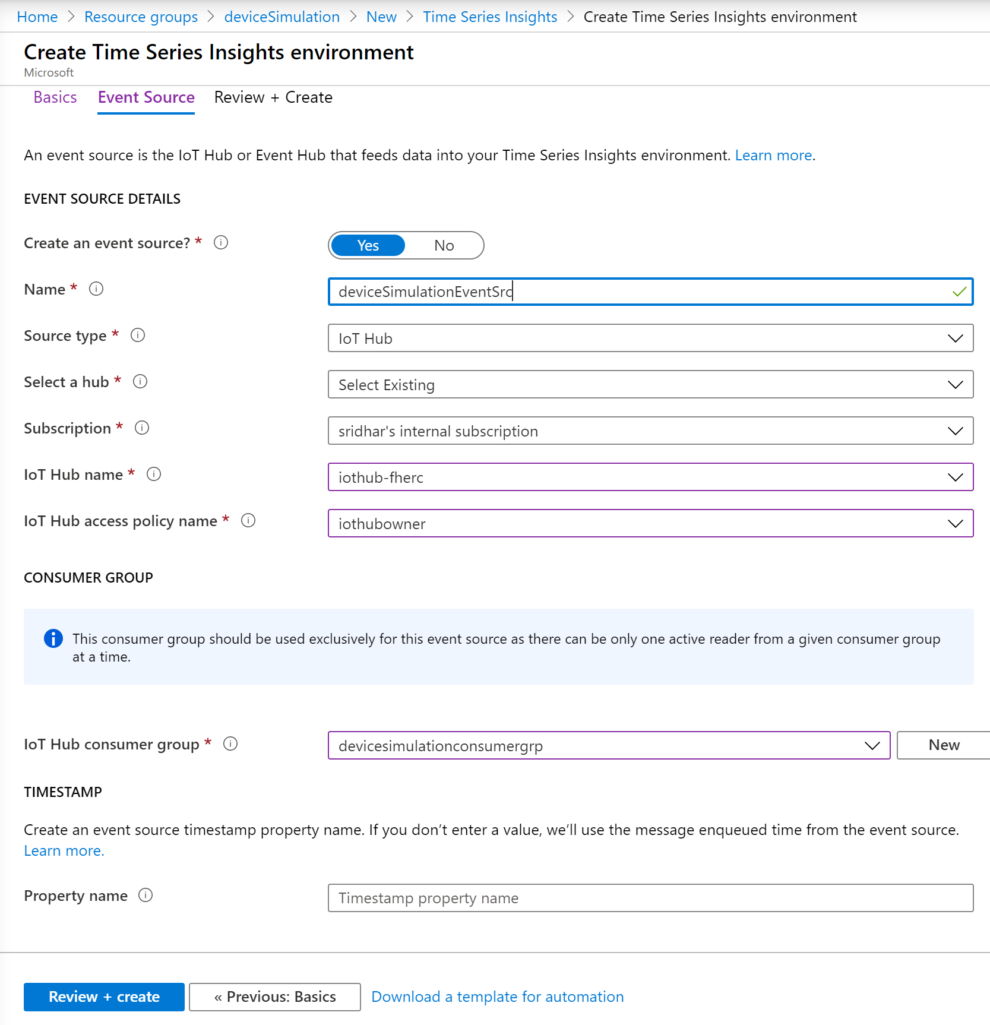
Setup Time Series Insights
Add a Time Series Insights resource to the same resource group and configure it like below

Slide 16
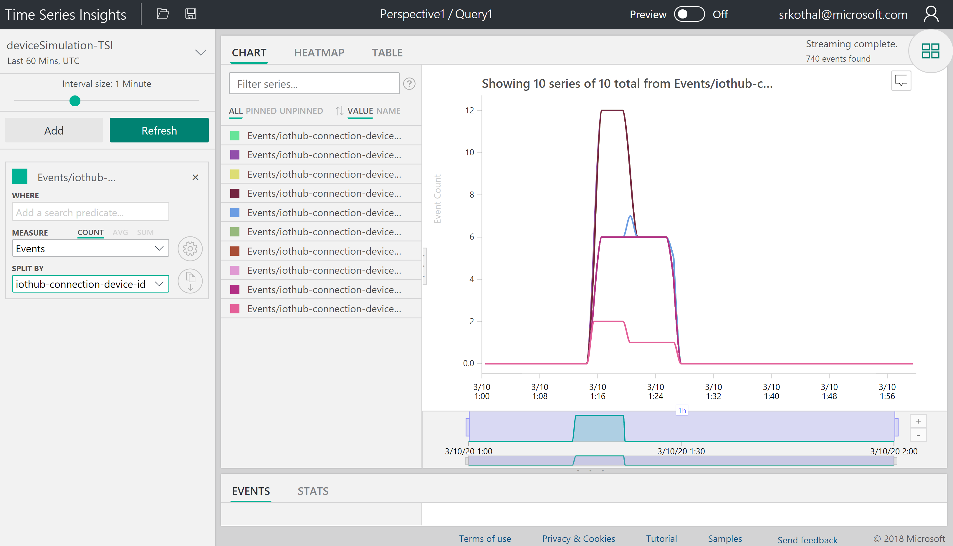
Setup Time Series Insights
Steps:
Create an instance of Time Series Insights
Point it to the iotHub
View the events from the devices
10 devices

Slide 17
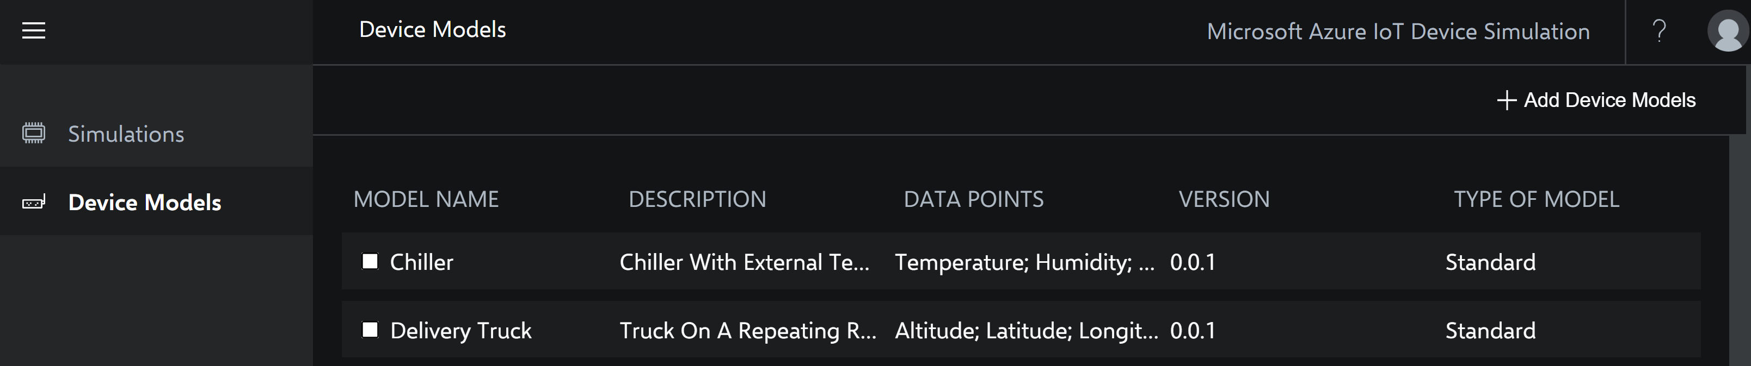
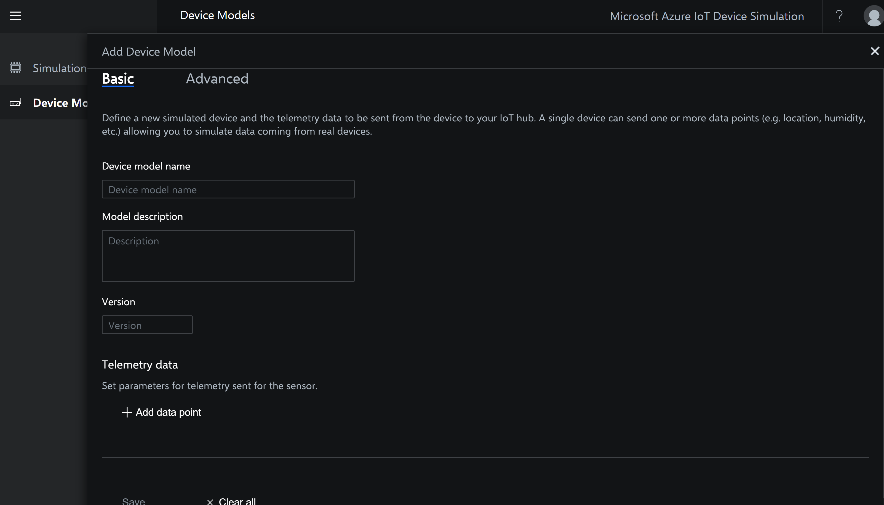
Add Device Models
Two options “Basic” and “Advanced” available

Slide 18
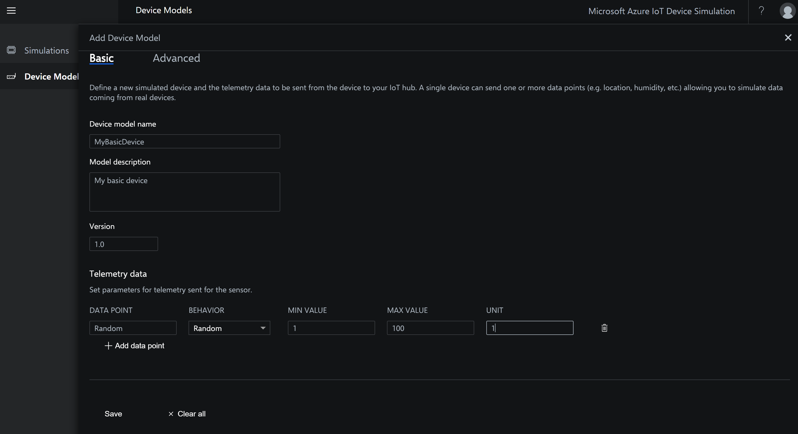
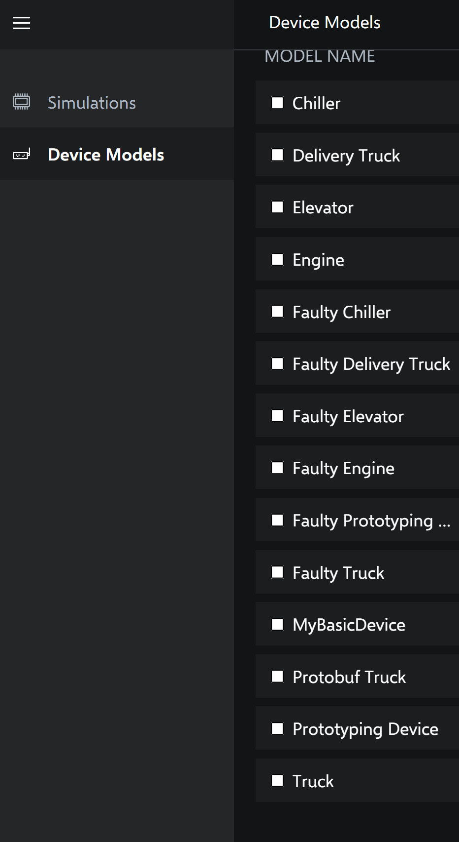

Add “Basic” Device Model

Slide 19
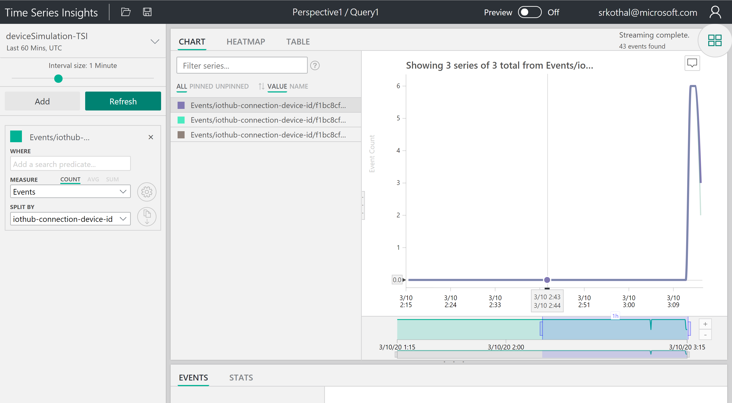
Setup Time Series Insights
Steps:
Refresh the instance of Time Series Insights
Select Measure as “Events”
Select Split By as “iothub-connection-device-id”

Slide 20
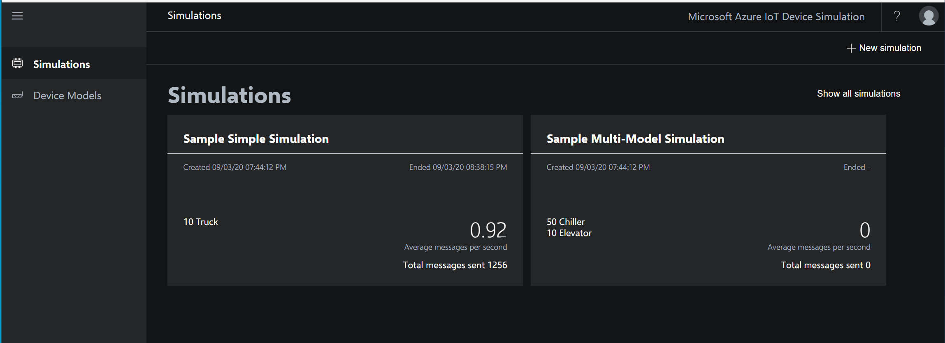
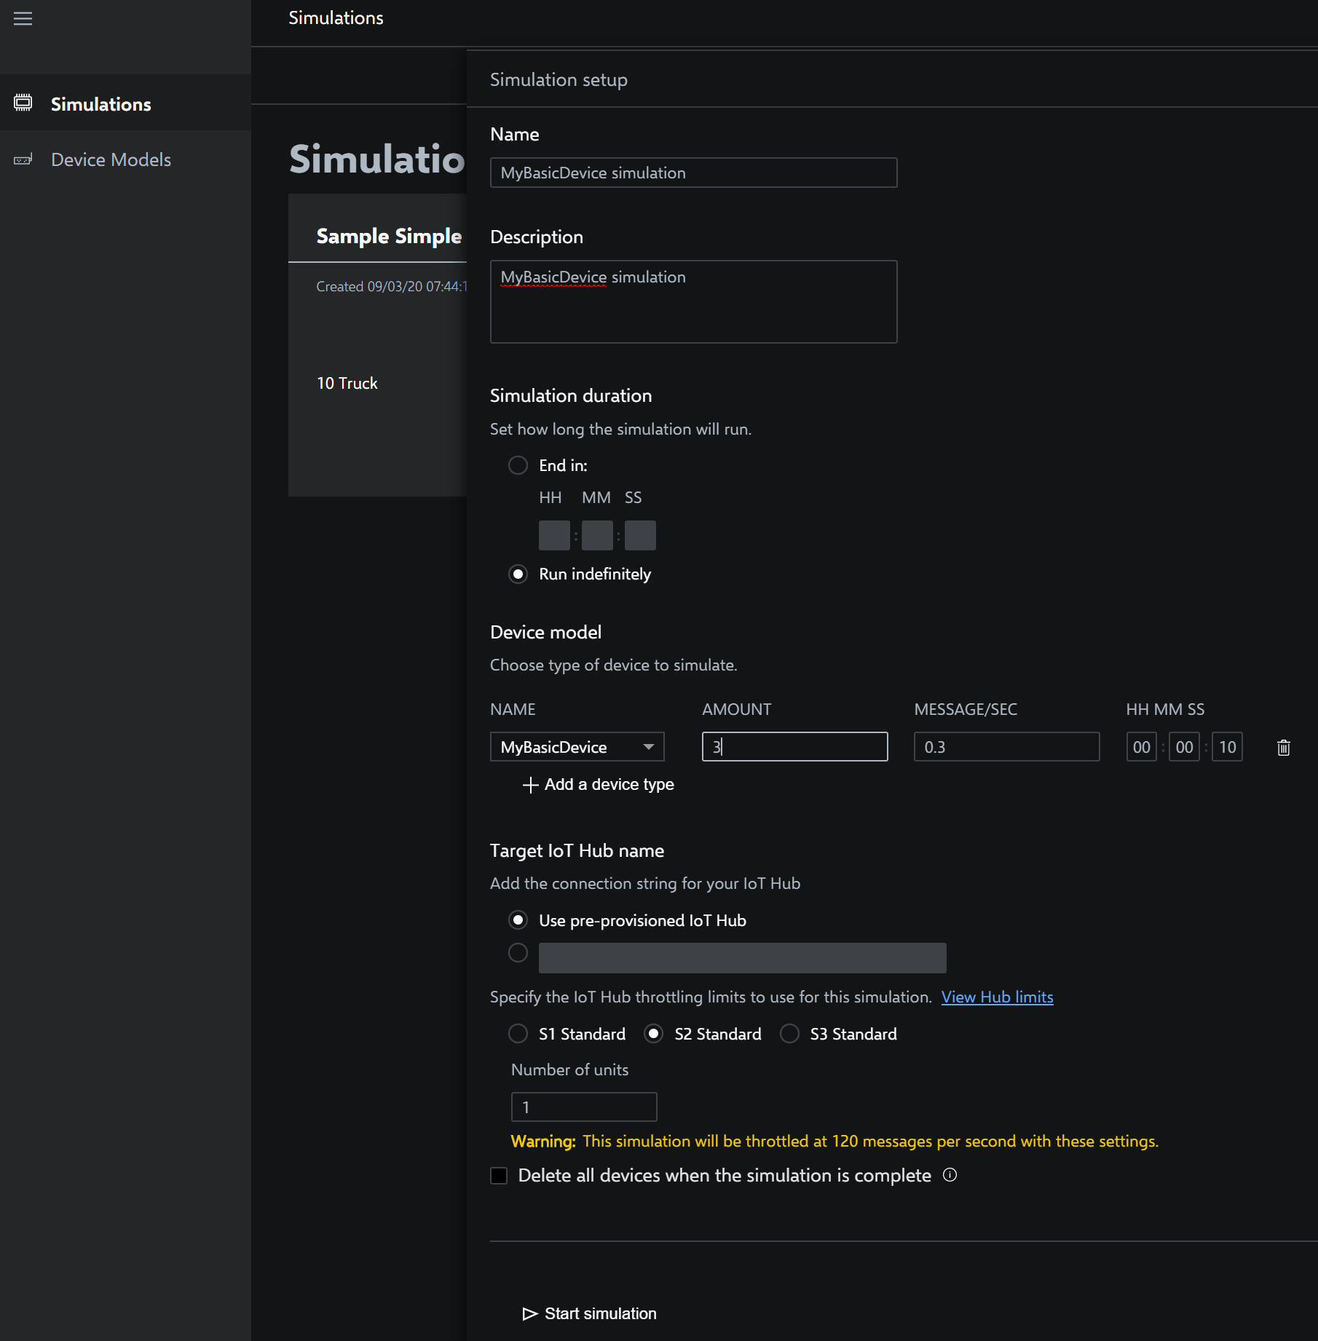
New simulation with “Basic” device model

Slide 21
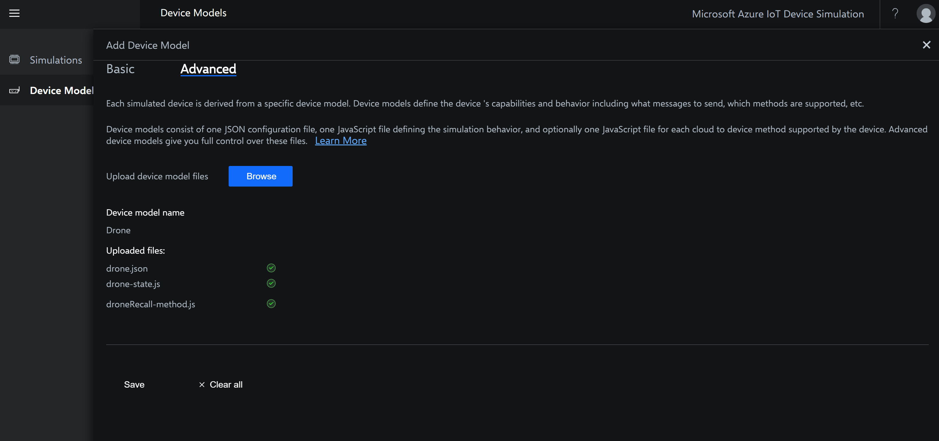
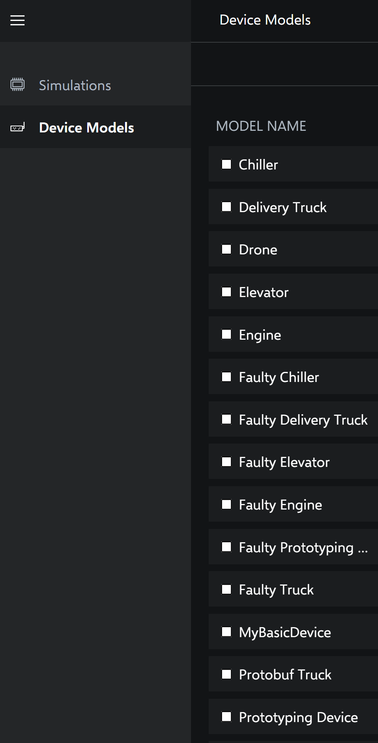
Add “Advanced” device model
Download the drone device model files from
https://github.com/dhanow/iot-solution-accelerators/tree/master/scripts/device-simulation

Slide 22
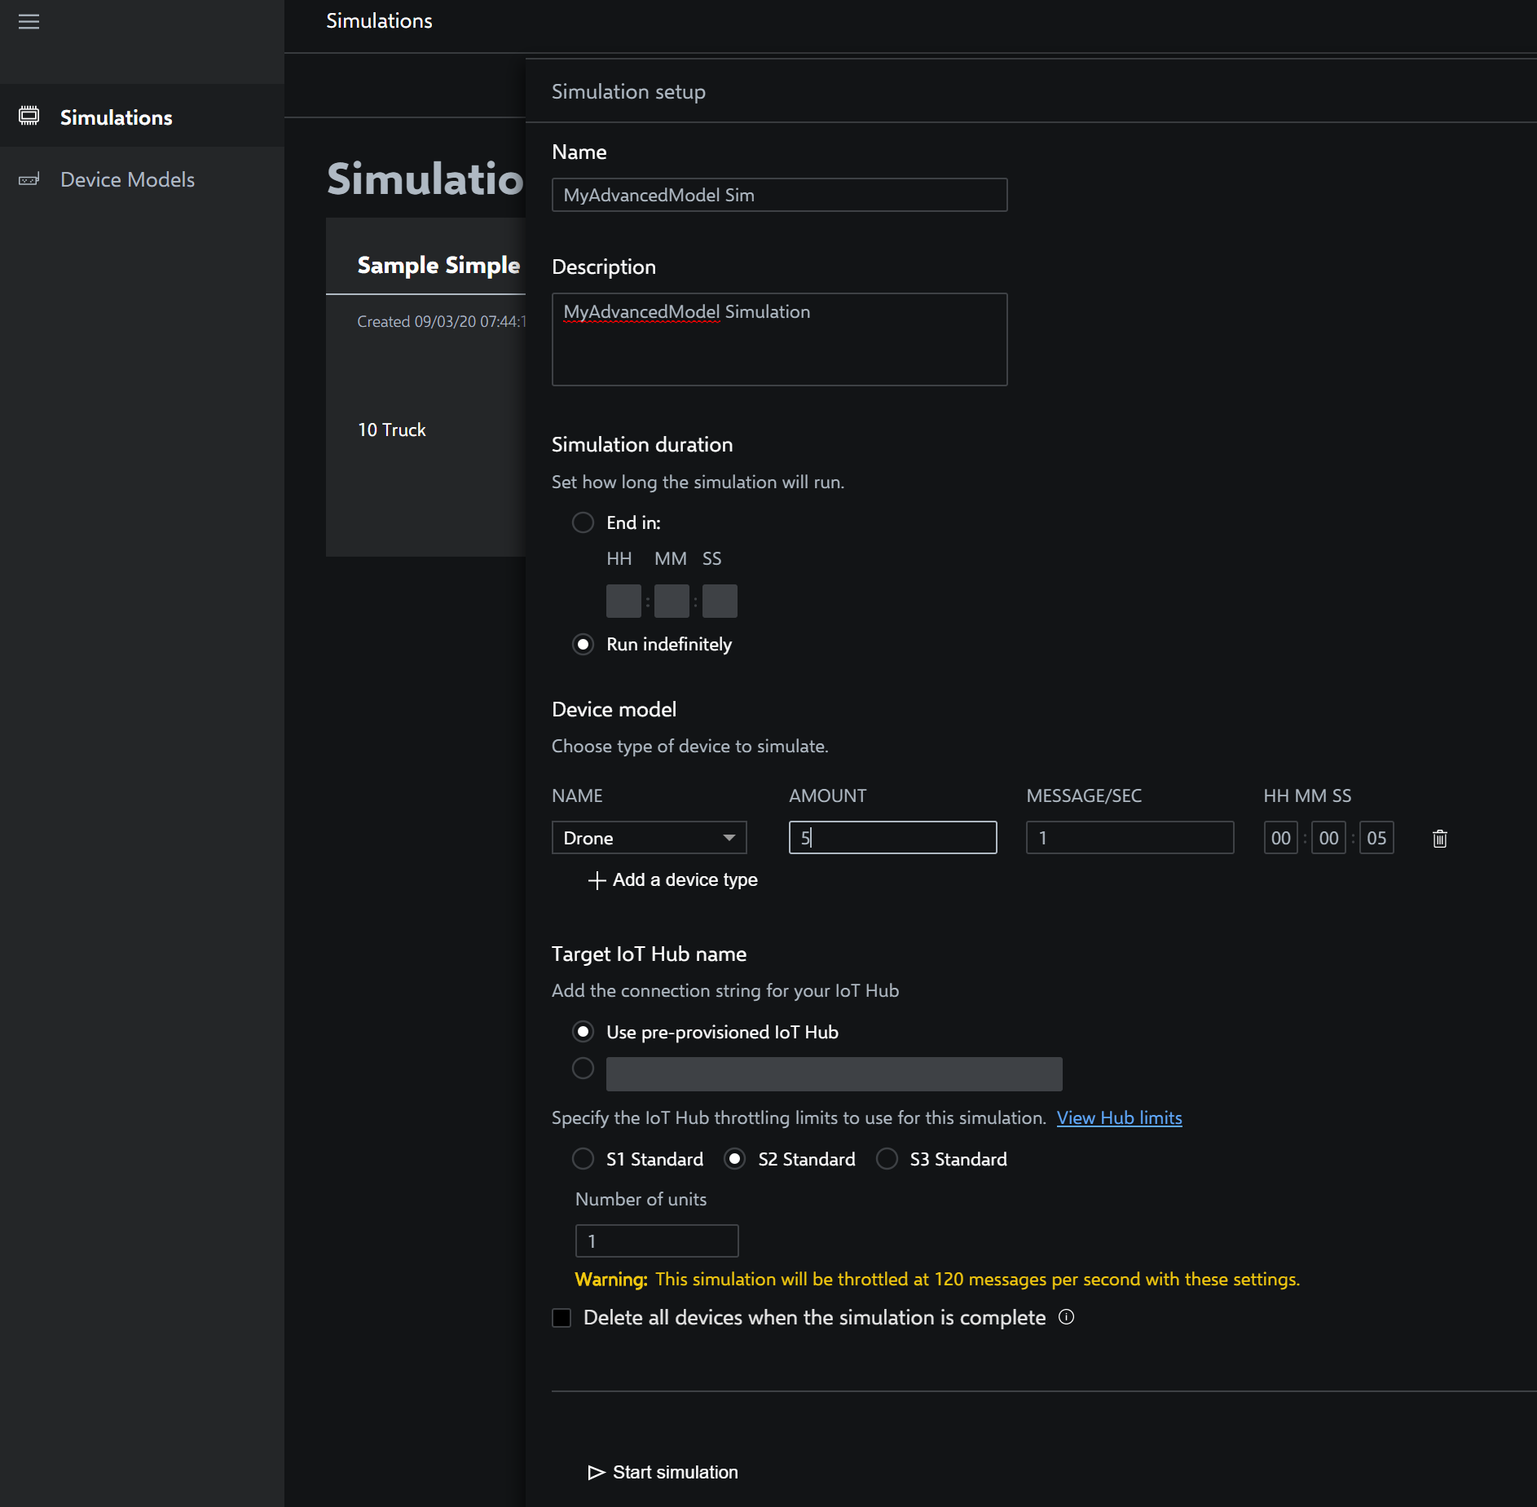
New simulation with “Advanced” device model

Slide 23
Thank You

